Slide 1
小学校 英単語スライド
～日本語を読んで、英語で書いてみよう～

Slide 2
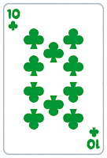
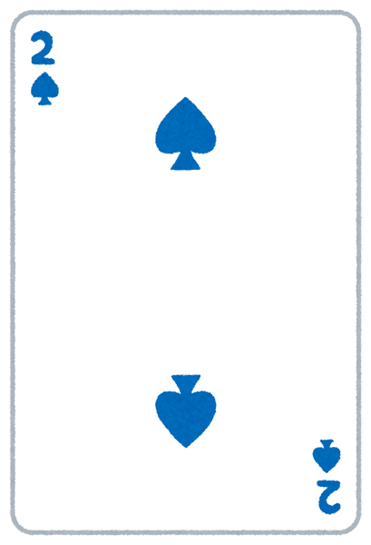
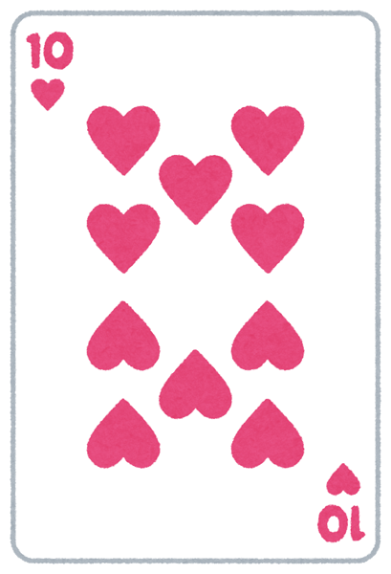
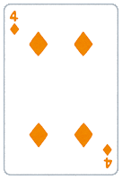
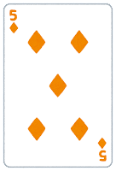
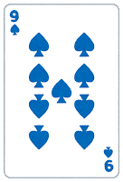
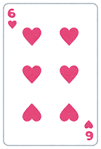
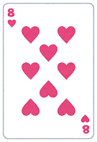
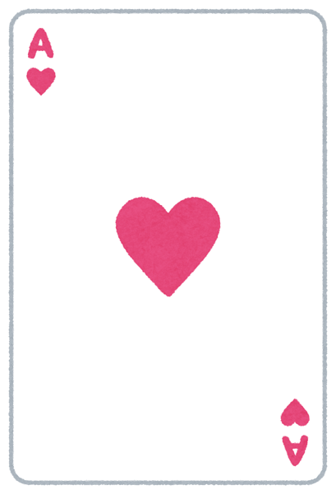
数字編

Slide 3
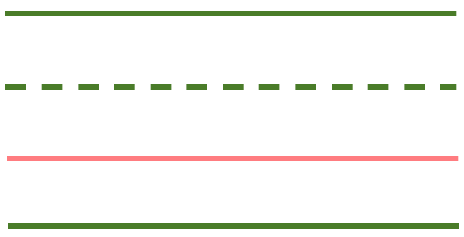
1

Slide 4
1
one

Slide 5
2

Slide 6
2
two

Slide 7
3

Slide 8
3
three

Slide 9
4

Slide 10
4
four

Slide 11
5

Slide 12
5
five

Slide 13
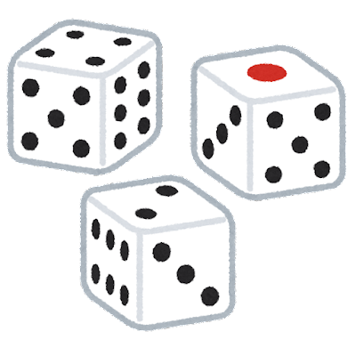
6

Slide 14
6
six

Slide 15
7

Slide 16
7
seven

Slide 17
8

Slide 18
8
eight

Slide 19
9

Slide 20
9
nine

Slide 21
10

Slide 22
10
ten

Slide 23
11

Slide 24
11
eleven

Slide 25
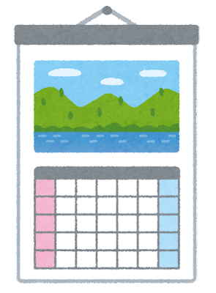
12

Slide 26
12
twelve

Slide 27
13

Slide 28
13
thirteen

Slide 29
14

Slide 30
14
fourteen

Slide 31
15

Slide 32
15
fifteen

Slide 33
16

Slide 34
16
sixteen

Slide 35
17

Slide 36
17
seventeen

Slide 37
18

Slide 38
18
eighteen

Slide 39
19

Slide 40
19
nineteen

Slide 41
20

Slide 42
20
twenty

Slide 43
21

Slide 44
21
twenty-one

Slide 45
22

Slide 46
22
twenty-two

Slide 47
23

Slide 48
23
twenty-three

Slide 49
24

Slide 50
24
twenty-four

Slide 51
25

Slide 52
25
twenty-five

Slide 53
26

Slide 54
26
twenty-six

Slide 55
27

Slide 56
27
twenty-seven

Slide 57
28

Slide 58
28
twenty-eight

Slide 59
29

Slide 60
29
twenty-nine

Slide 61
30

Slide 62
30
thirty

Slide 63
40

Slide 64
40
forty

Slide 65
50

Slide 66
50
fifty

Slide 67
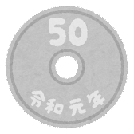
60

Slide 68
60
sixty

Slide 69
70

Slide 70
70
seventy

Slide 71
80

Slide 72
80
eighty

Slide 73
90

Slide 74
90
ninety

Slide 75
100

Slide 76
100
one-hundred

Slide 77
0

Slide 78
0
zero

